Slide 1
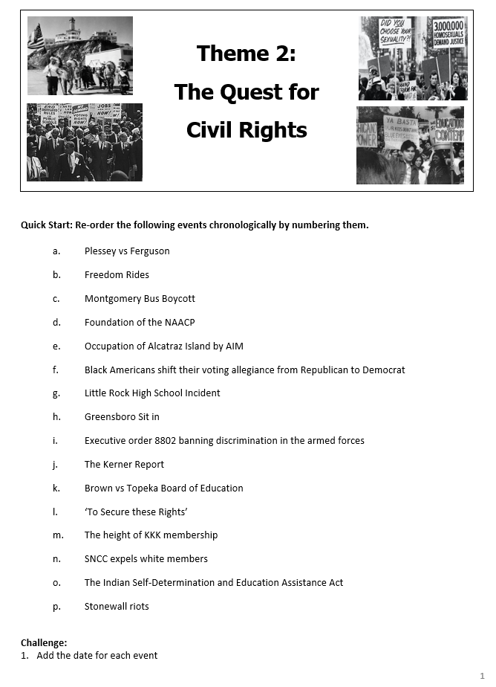
How and why do historians disagree over Reagan’s presidency?
Quick Start:
Reorder the events so they are chronologically correct.
Challenge:
Add a date for each one.
Write a short sentence to explain why each was a significant turning point for civil rights.
Notes:
Heads and tails from Gay Rights +/- sheet from last week.

Slide 2
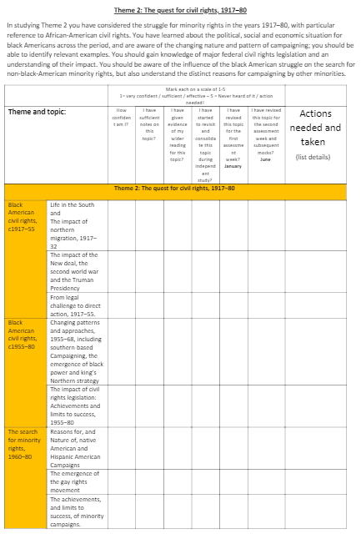
Theme 2 – Quest for Civil Rights
How and why do historians disagree over Reagan’s presidency?
How confident are you with this topic?
Complete the checklist to review your knowledge on this topic so far.
Remember: you have a checklist like this for all four themes and Reagan in your Course Guides.

Slide 3
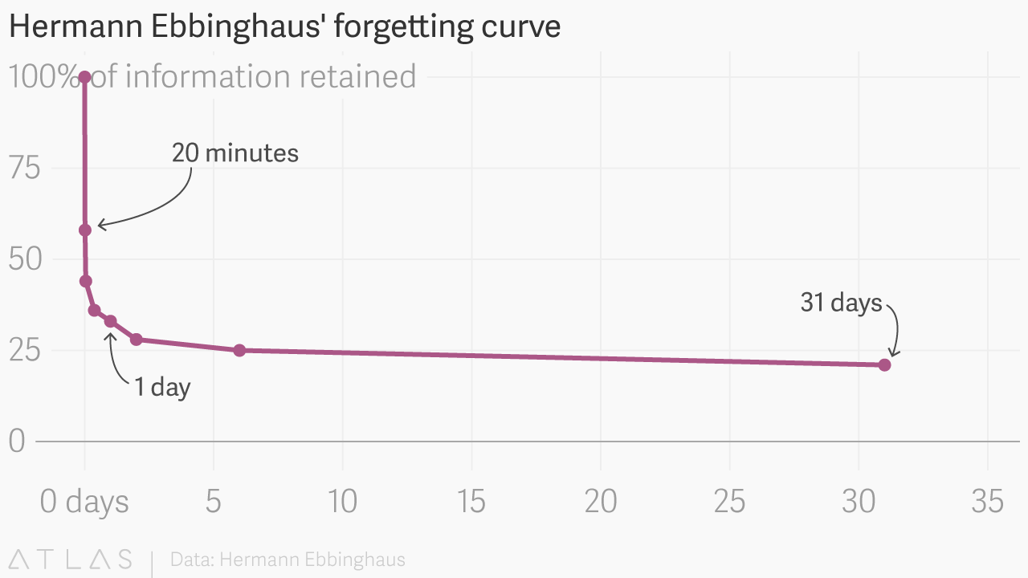

Slide 4
You should already be revising… if you aren’t start now!
Organised folders.
Revision checklists.
Revision materials.
Use them!

Slide 5
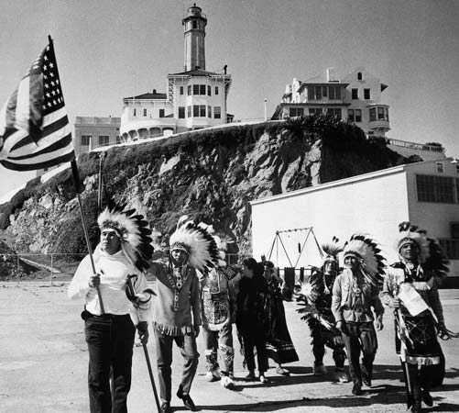
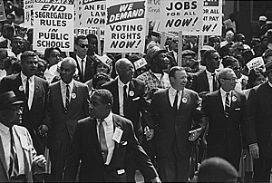
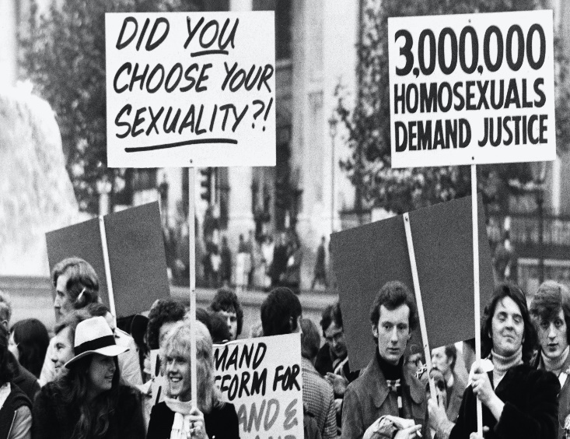
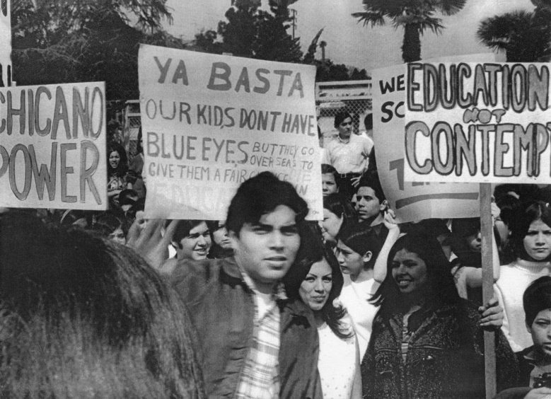
What does the Quest for Civil Rights entail?
How and why do historians disagree over Reagan’s presidency?
Efforts to gain civil rights (equal status) for:
Black Americans
Hispanic Americans
Native Americans
Gay Americans

Slide 6
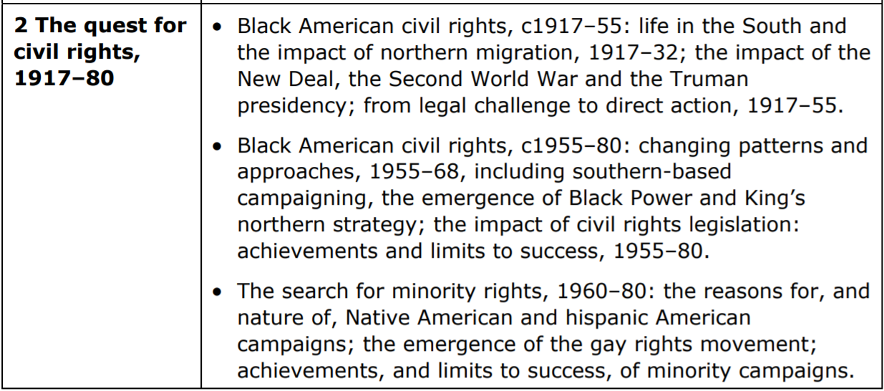
What to revise?
How and why do historians disagree over Reagan’s presidency?
Key focus areas:
Tactics
CR Leaders
Events
Success? Changing Rights.
Politics/Gov’t Approach

Slide 7
Black American Civil Rights to 1932
How and why do historians disagree over Reagan’s presidency?
Life in the South | Life in the North
90% live here – Jim Crow = segregation & inferior education. Mostly poor sharecroppers. No political power due to voting restrictions: poll tax, literacy tests, white registrars. Lynching was common & unpunished. Some CR attempts, but largely unsuccessful: Booker T. Washington v W.E.B. DuBois NAACP campaign for anti-lynching: Dyer Anti-Lynching Bill (1922) but didn’t stop. | No segregation on transport, but de facto housing segregation. Factories = work = Great Migration, but low income & expensive ghetto accommodation. Great Migration spread racial tension. Could vote: ghettos = voting power. Some elected representatives, e.g. DePriest (1929). Occasional lynchings by riots more common (Ossian Sweet). Some rights challenges: Marcus Garvey (UNIA) ‘return to Africa’ Harlem Movement – cultural pride Trade Unionism (Philip Randolf – railroad porters) Harding & Coolidge supported greater opportunities, but laissez-faire. War increased consciousness

Slide 8
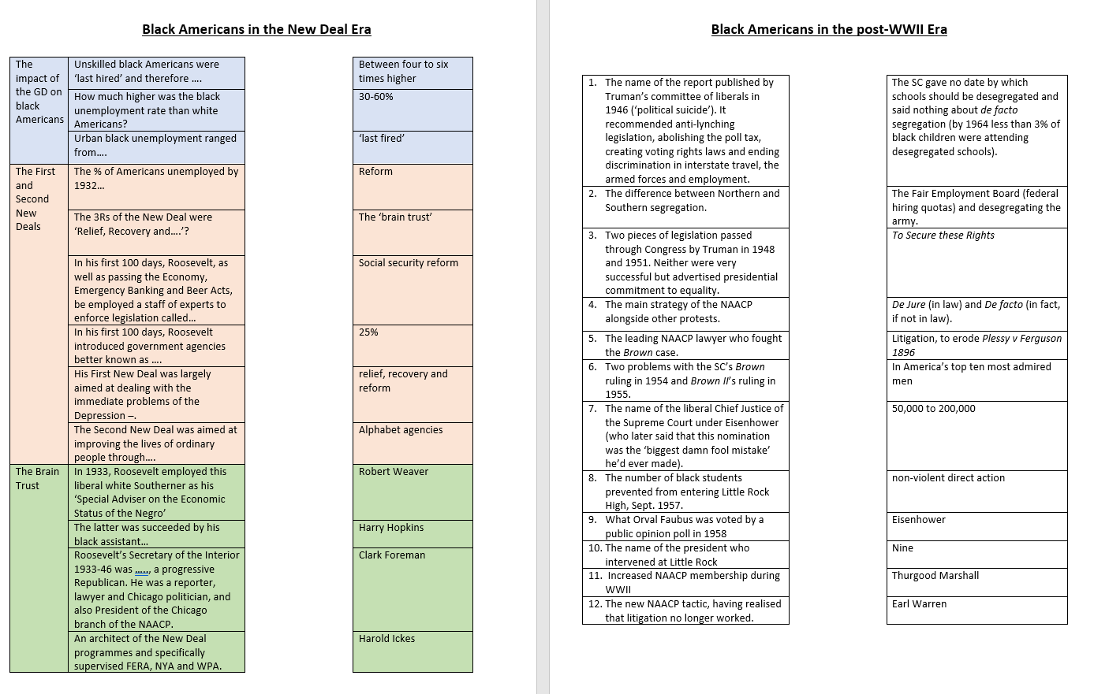
Black American Civil Rights to 1955
How and why do historians disagree over Reagan’s presidency?
Complete the two match up activities on pp.8-9:
The Impact of the New Deal on Black Americans There are TWO mistakes – can you spot them?
Black Americans in the post-WWII era.
Challenge:
What was the impact of the following New Deal agencies on black Americans?
AAA
TVA
Social Security Act
FHA
CCC

Slide 10
Challenge:
What was the impact of the following New Deal agencies on black Americans?
AAA – many black farmers evicted & swindled.
TVA – Segregationist practices, but improvements after NAACP expose in 1936.
Social Security Act – Many black workers excluded due to farm & domestic work.
FHA – received 30% of new housing.
CCC – employed 200,000.

Slide 11
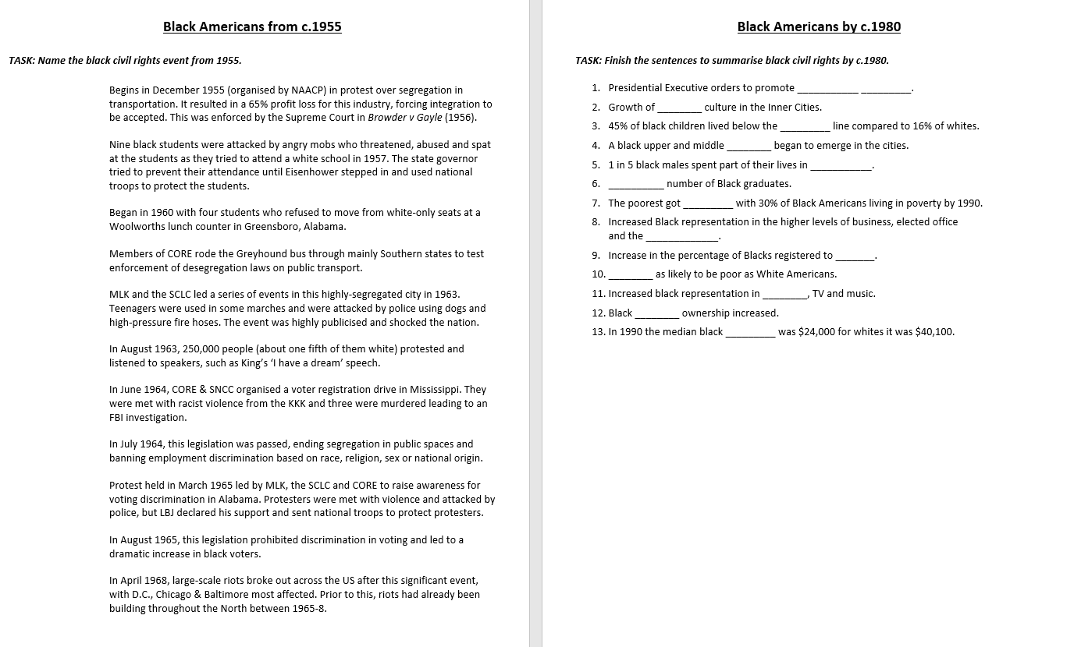
Black American Civil Rights to 1955
How and why do historians disagree over Reagan’s presidency?
Complete the activities on pp.10-11.
Identify case or event that led to change.
Complete the sentences to recap civil rights for black Americans by 1980.
Challenge: What is missing from this summary of black civil rights after 1955?

Slide 12
Montgomery Bus Boycott
Affirmative Action
gang
poverty
class
Little Rock
prison
Rising
poorer
Sit Ins
professions
Freedom Rides
vote
Twice
sport
Birmingham
home
income
March on Washington
Freedom Summer
Challenge: What is missing from this summary of black civil rights after 1955?
CRA
Selma to Montgomery
VRA
MLK Assassination

Slide 13
Hispanic Civil Rights in the North
Driven by poor employment , housing & education, poverty & discrimination.
Some successful litigation challenged discriminatory practices and segregation.
LULAC encouraged voting – campaigns attracted LBJ attention, who provided aid to Hispanic ghettos in an attempt to gain Mexican votes.
Lobbying government – e.g. creation of Equal Employment Opportunity Commission. LBJ appointed Vincente Ximenez to EEOC after LULAC walkout over poor Mexican rep.
Union activity – Cesar Chavez non-violent direct action & striking – Californian grape farms → 17m Americans = labour-friendly legislation for Mexican workers in CA, 1975.
Grassroots campaigns – Puerto Rican Movement instilled racial pride & community help.
Chicanos campaign v discrimination, attract attention (e.g. ‘blowouts’), seek political representation (LRUP) & pride (esp. with young), but LRUP policies alienated some.
Notes:
The Raza Unida Party, officially Partido Nacional de La Raza Unida is a Chicano organization. It was created in the early 1970s and became prominent throughout Texas and Southern California

Slide 14
Native American Civil Rights in the North
Key groups very much mimicked black American groups. (e.g. NCAI = NAACP; AIM = BP).
Successful litigation over discrimination in employment, schooling and broken treaties.
Younger generation more impatient with ‘slow’ litigation → NVDA: e.g. ‘fish-ins’. Similarly, legal findings were often ignored by local/state authorities.
Red Power used litigation, publicity raising – protest marches & literature, police monitoring, grassroots attempts to improve poor conditions and attacking racist language.
Occupations raised great public awareness, media & government attention. E.g. Alcatraz = media; Wounded Knee (AIM) = federal investigation & greater sensitivity to concerns.
1968 CR Act = ‘Indian Bill of Rights’ – access to health services, housing, education & employment, and welfare & poverty benefits. BUT some felt it encouraged dependency.

Slide 15
Gay American Rights
How and why do historians disagree over Reagan’s presidency?
Classified as a mental illness by the API until 1974.
Lobbying and publishing since WWII, but with little success.
1951: Mattachine Society, but later gave way to more assertiveness in 1960s.
Stonewall: 1969. First gay pride the following year.
1970: NY Gay Liberation Front encouraged, ‘come out’ proudly.
Ordinances banning discrimination based on sexuality in SF (1972) & NYC (1979).
Harvey Milk first openly gay elected official in Ca. 1977. Assassinated 1978.
1978 Ca. voters defeat Proposition 6 (move to repeal 1975 law for teachers).
1980 Democratic Party platform supported equality for all v religious right.

Slide 16
This is a start for revision…
… but this is not everything!!
Key focus areas:
Tactics
CR Leaders
Events
Success? Changing Rights.
Politics/Gov’t Approach
You must develop your revision beyond these examples.
Go back to the checklists & ensure you have adequate revision materials and examples for each group and key focus area.

Slide 17
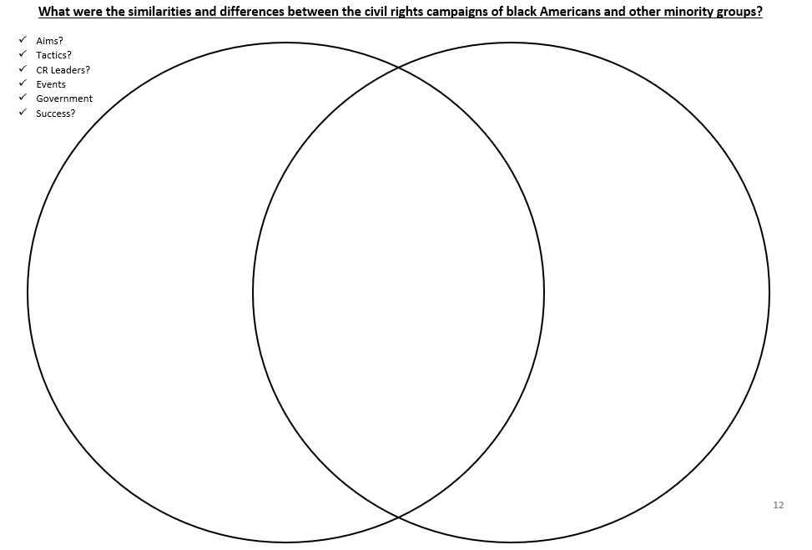
p.12

Slide 18
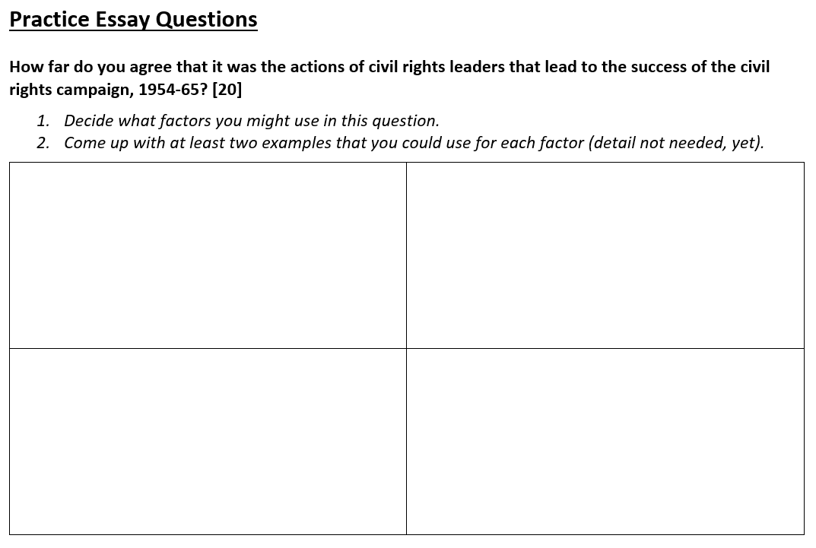
Just do task 1 for now!

Slide 19
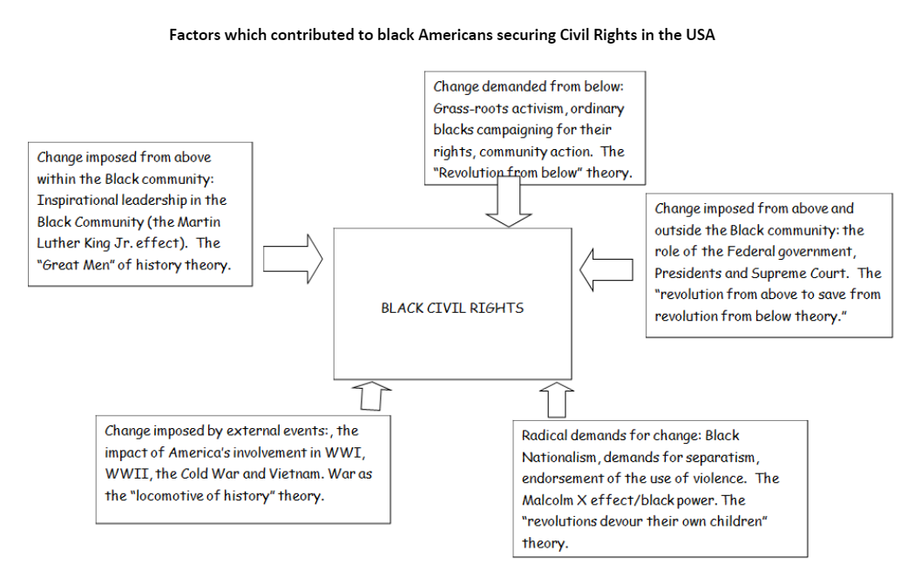

Slide 20
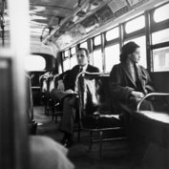
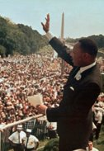
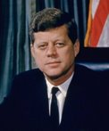
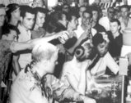
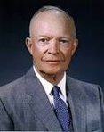
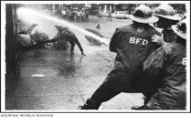
Legal Action
(Supreme Court rulings & NAACP cases)
The Role of leading campaigners such as MLK Jnr.
Which factor (reason) was MOST important in helping to achieve civil rights?
Which factors hindered progress most?
Presidential Intervention
Non-violent Direct Action

Slide 21
Complete Task 2

Slide 22
1954 Brown v Topeka
1960 Browder v Gayle
NAACP tactics
MLK’s speech & Leadership
Organisation
Publicity
Rosa Parks
Malcolm X
Montgomery Bus Boycot
Sit ins
Freedom Rides
Birmingham
Selma to Montgomery
Eisenhower & Little Rock 9
JFK wrote CRA after Birmingham caught att’n.
Johnson: CRA & VRA

Slide 23
Legal Action
(Supreme Court rulings & NAACP cases)
The Role of leading campaigners such as MLK Jnr.
What ‘valid criteria’ can we apply to these factors? Use p.14 to help you.
Presidential Intervention
Non-violent Direct Action

Slide 24
Page 16
What makes this a L5 answer?

Slide 25
Planning Your Essay
How and why do historians disagree over Reagan’s presidency?
Go back to you examples.
How do you want to answer this question?
Write your own introduction to this question (it should include your brief, but clear, judgement). (You may use the structure strip to help you with this.)
Plan out how you would answer this question. (Structure, key arguments, key supporting examples.) Make sure you have a consistent judgement throughout!
Structure for factor approach should be: intro, PEEs & conclusion.
Remember, be realistic about what you can achieve in the time frame (40min).

